Slide 1
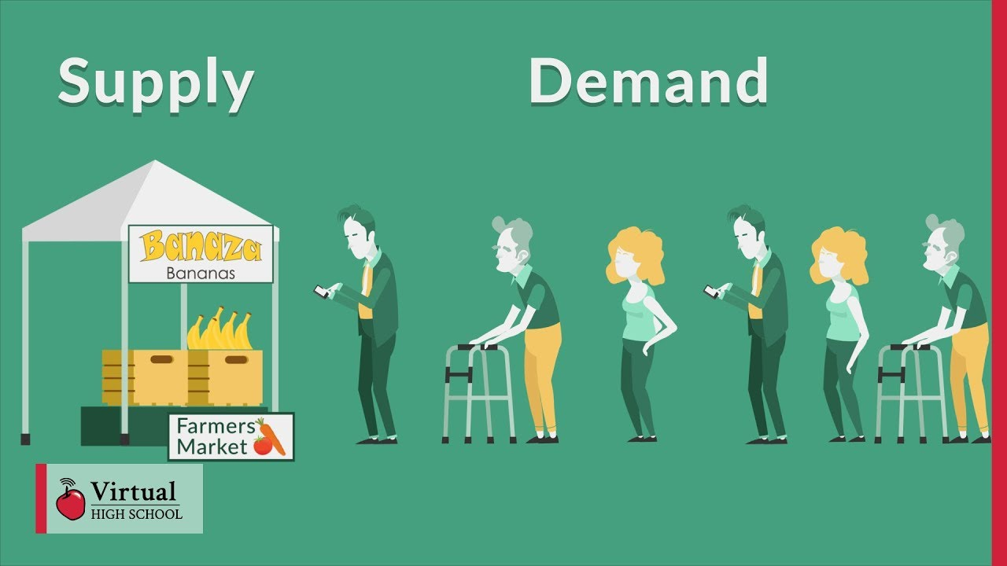

Unit 4 Chapter 4
THE MARKET FORCES OF DEMAND AND SUPPLY

Slide 2
MARKETS AND COMPETITION
Markets
Competitive markets
There are non-competitive markets as well
Price taking behaviour in competitive markets
Assume perfect competition in the analysis

Slide 3
DEMAND: individual demand curve
Quantity demanded
Law of demand: ceteris paribus (other things remaining the same), there is an inverse relationship between the price and quantity demanded of a good
Ceteris paribus: The law of demand holds only when other things remain the same
Demand schedule and demand curve

Slide 4
DEMAND: individual and market demand
Market demand: the sum of all the individual demands for a particular good or service
Assuming there are only two individuals in the market
Market demand curve is considered in the analysis
Total quantity demanded in the market for variations in price, keeping other determinants the same

Slide 5
DEMAND: shifts in the demand curve
Market demand is not necessarily stable because of the changes in non-price factors
Such a change in demand is identified as a shift in the demand curve
Increase in demand
Decrease in demand
Factors shifting the demand curve

Slide 6
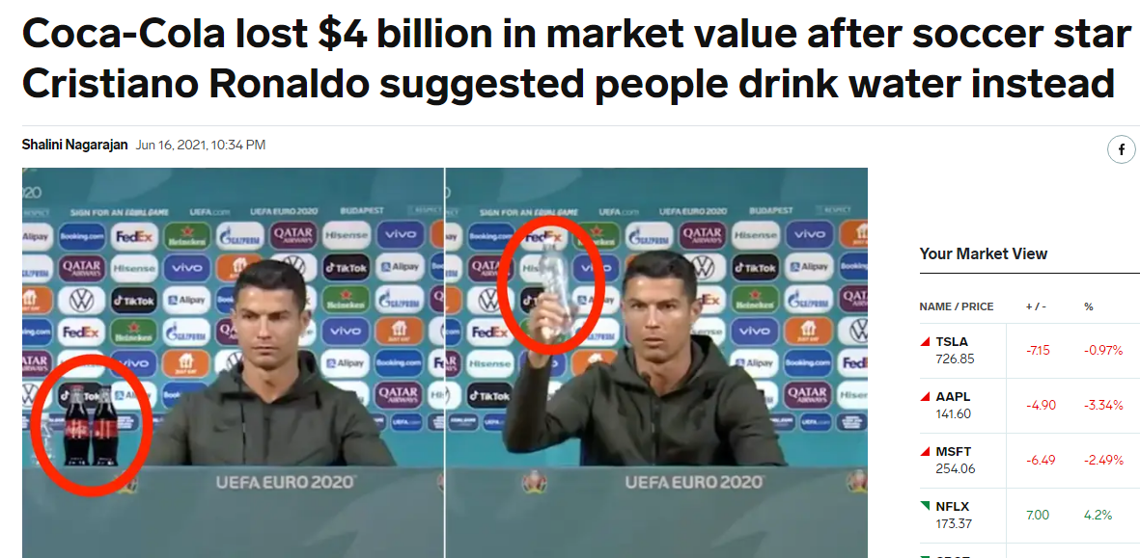
DEMAND: shifts in the demand curve
Income
Price of related goods
Tastes and preferences
Expectations
Number of buyers

Slide 7
SUPPLY: individual and market supply curve
Quantity supplied
Law of supply: ceteris paribus, there is a direct relationship between the price and quantity supplied of a good
Supply schedule and supply curve
Market supply: the sum of all the individual supply of a particular good or service
Market supply curve is considered in the analysis

Slide 8
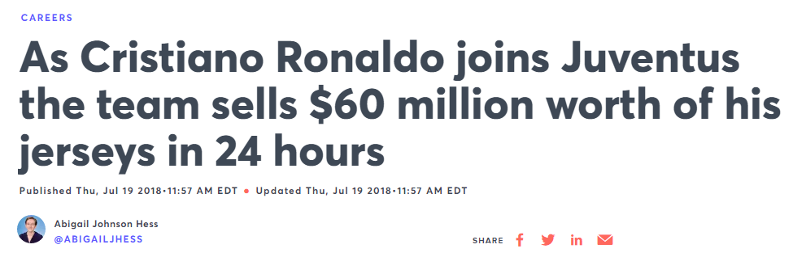
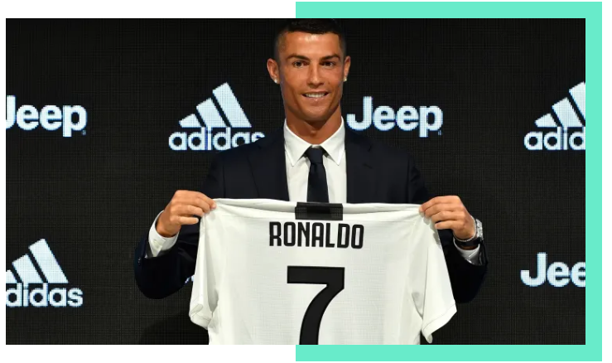
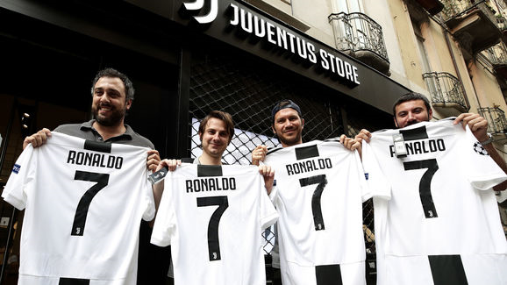
SUPPLY: shifts in supply curve
Input prices
Technological innovations
Market expectations
Number of sellers

Slide 9
DEMAND and SUPPLY: equilibrium
Market equilibrium, equilibrium price and quantity
Also called market clearing price
Surplus or shortage occurs if market price is not the same a equilibrium price, and price adjusts
Law of supply and demand: the claim that the price of any good adjusts to bring the quantity supplied and the quantity demanded of that good into balance

Slide 10
DEMAND AND SUPPLY: changes in equilibrium
Three steps of analysing the changes in equilibrium
Determining the shift in demand or supply curve or both
Determine the direction of the shift, left or right
Using a supply-demand diagram and comparing the new equilibrium with the old one
Three possible scenarios of changes in equilibrium
Due to a shift in the demand curve
Due to a shift in the supply curve
Due to a shift in both the demand and supply curves
Prices stabilise the economy and make the allocation of all resources

